Slide 1
projectfacts API
Compact Guide
Version 0.36, requires projectfacts 6.00 oder later 2021-03-09

Slide 2
Overview
Buzzwords: Which standards and best practices are used?
Authorization: What can be done via the API
Authentication: Security concept of the API
  Login-Auth
  Token-Auth
  Interface-Auth
projectfacts API explorer
Example: Update of a company’s address
Things to keep in mind

Slide 3
Buzzwords
Before we go on: You should be familiar with these topics...
HATEOAS
REST
JSON
BASIC Auth

Slide 4
Authorisation: What can be done via API?
In general, an API user has the same permissions as in the web app (projectfacts)
If a user can delete projects in the web app, he can do it also via API. This cannot be prevented.
Also, you cannot keep that user from developing his own app to delete projects:
You cannot prevent an user from using the API at all!
If an user may not book times in the web app, you cannot allow it via API either.
Exception: Usage of the API via projectfacts interfaces
(more later...)
!
*

Slide 5
Authentication: Security concept of the API
You cannot use the API just with your projectfacts password:
Transfer password with every request?
➜ Risk of it getting tapped😬
One client gets compromised?
➜ Change password
➜ All clients would get disconnected.😞
The password would be stored on the Client! 😲

Slide 6
Authentication: Login Authentication
The only resource you can access using your projectfacts credentials (login authentication) is the device resource. It has to be created (PUT) when logging in from your App the first time:
POST on https://sync.projectfacts.de/api/device/
{
"email": "user@provider.com",
"password":"projectfactsPassword",
"deviceName": "YourAppName",
"deviceType": "de.fivepoint.other",
}

Slide 7
Authentication: Login Authentication
If there is a user with matching email and password, the server responds with the new device resource.
It contains the DeviceID and the API-Token, you have to authenticate all following requests with:
{
"_id":"10001234",
"token": "D1C2B3A4",
"deviceName": "NameOfYourApp",
[...]
}
These have to be stored by your app.
Never store the original password!

Slide 8
Authentication: Login Authentication
If there is a user with matching email and password, the server responds with the new device resource.
It contains the DeviceID and the API-Token, you have to authenticate all following requests with:
{
"_id":"10001234",
"token": "D1C2B3A4",
"deviceName": "NameIhrerAnwendung",
[...]
}
Dies muss die App speichern,
niemals das projectfacts Passwort!
You get the Token only this one time!

Slide 9
Authentication: Token Authentication
Your apps local storage:
{
"_id":"10001234",
"token": "D1C2B3A4",
[...]
}
// API-Request in Javascript
var credsB64 = window.btoa(device._id + ':' + device.token)
var xhr = new XMLHttpRequest();
xhr.open('GET', url, true);
xhr.setRequestHeader('Authorization', 'Basic ' + credsB64);
xhr.onload = function(response) { /*...*/};
xhr.send();

Slide 10
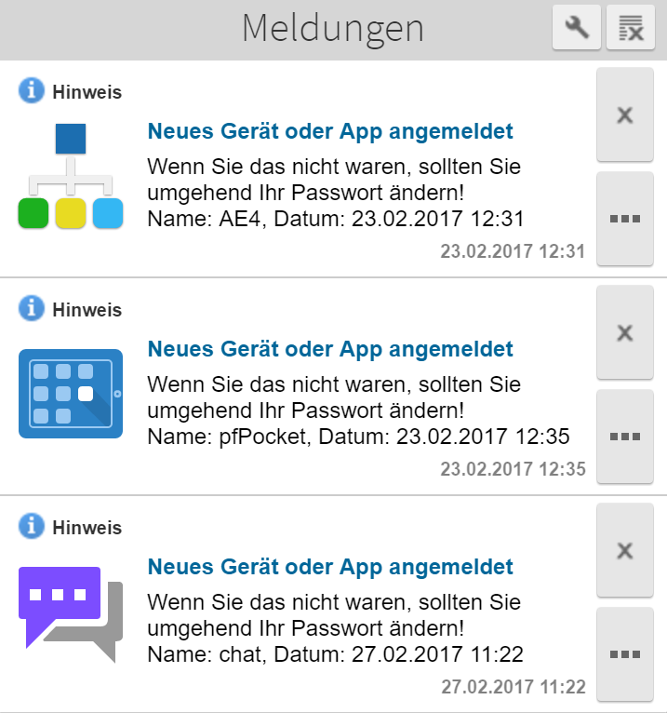
Authentication: Token Authentication
All regular requests are secured with BASIC-Auth using Device ID and Device Token: The user of your app as well as the device he is using.
A devices permission can be withdrawn by deleting the device within projectfacts ( “My devices”).
Other devices / apps are not affected.

Slide 11
Authentication: Interface Authentication
Use for non-personal apps, which do not act “on behalf” of a user
(e.g. Check-In/Out-Terminal)
BASIC-Auth using Interface-ID and -Password
Password is set in projectfacts configuration (Interfaces)
No user-permissions. Permissions result from the interfaces settings.
Restriction of connecting IP-address is possible.
More to come

Slide 12
projectfacts API explorer
https://sync.projectfacts.de/htdocs/apps/apiexplorer/index.html
or root of your pf-Servers + /htdocs/...
HTML5 / AngularJS-App
Browse our API
  How are resources and
  relationen represented?
  How to use queries?
Track communication using the browser's developer tools
Find JSON-Representants as Typescript-Classes:
https://sync.projectfacts.de/api/api/dto.ts
You should take a look!

Slide 13
Example: Update a company's address
We search for “Example corp” in our app and update its address.
These steps are necessary:
GET on /api/contact including a search query
GET on the desired contact resource
GET on the contacts main address
PUT on that address

Slide 14
Example: Update a company's address - Step 1
We look for “Example corp.” (The user typed “examp” into our app)
Perform GET using deviceID and token as BASIC-Auth-Header on https://sync.projectfacts.de/api/contact?caption*=examp
Resource to search:
Field, we filter on:
Operator:
search value:
contact Contact resource
caption Caption of the element
*= “contains” opposed to = “equals”
examp (op = is case insensitive)

Slide 15
Example: Update a company's address - Step 1
We look for “Example corp.” (The user typed “examp” into our app)
GET https://sync.projectfacts.de/api/contact?caption*=examp
Result (excerpt)
{
"size": 3, "offset":0, "limit":100,
"items": [
{"caption":"Max TexaMP","href":"https://…/api/contact/1234","value":1234},
{"caption":"Ben Examplename","href":"https://…/api/contact/2345","value":2345},
{"caption":"Example corp.","href":"https://…/api/contact/3456","value":3456}
]
}

Slide 16
Example: Update a company's address - Step 1
We look for “Example corp.” (The user typed “examp” into our app)
GET https://sync.projectfacts.de/api/contact?caption*=examp
Result (excerpt)
{
"size": 3, "offset":0, "limit":100,
"items": [
{"caption":"Max TexaMP","href":"https://…/api/contact/1234","value":1234},
{"caption":"Ben Examplename","href":"https://…/api/contact/2345","value":2345},
{"caption":"Example corp.","href":"https://…/api/contact/3456","value":3456}
]
}
HATEOAS:
continue here

Slide 17
Example: Update a company's address - Step 2
We load “Example corp.” (the user selected the third result entry)
GET https://sync.projectfacts.de/api/contact/3456
Result (excerpt)
{
"_id":3456, "_idKey":"39", _lastModifiedDate:"2015-11-19T10:44:26.000+0000"
"active":true,
"person":false,
"caption":"Example corp.",
"firstname":null,
"lastname":"Example corp.",
"description":"Address outdated\nMoved?",
"mainAddress":{"caption":";;Examplestreet 7;Examplecity;;122456;Deutschland",
"href":"…/api/contactfield/173880993","rel":"contactfield",
"title":"preferred postal address",
"value":173880993,"idKey":"174"}
}

Slide 18
Example: Update a company's address - Step 2
We load “Example corp.” (the user selected the third result entry)
GET https://sync.projectfacts.de/api/contact/3456
Meta information
begins with underscore
Result (excerpt)
{
"_id":28883816, "_idKey":"39", _lastModifiedDate:"2015-11-19T10:44:26.000+0000"
"active":true,
"person":false,
"caption":"Example corp.",
"firstname":null,
"lastname":"Example corp.",
"description":"Address outdated\nMoved?",
"mainAddress":{"caption":";;Examplestreet 7;Examplecity;;122456;Deutschland",
"href":"…/api/contactfield/173880993","rel":"contactfield",
"title":"preferred postal address",
"value":173880993,"idKey":"174"}
}

Slide 19
Example: Update a company's address - Step 2
We load “Example corp.” (the user selected the third result entry)
GET https://sync.projectfacts.de/api/contact/3456
Result (excerpt)
{
"_id":28883816, "_idKey":"39", _lastModifiedDate:"2015-11-19T10:44:26.000+0000"
"active":true,
"person":false,
"caption":"Example corp.",
"firstname":null,
"lastname":"Example corp.",
"description":"Address outdated\nMoved?",
"mainAddress":{"caption":";;Examplestreet 7;Examplecity;;122456;Deutschland",
"href":"…/api/contactfield/173880993","rel":"contactfield",
"title":"preferred postal address",
"value":173880993,"idKey":"174"}
}
Contacts can be persons
as well as organizations

Slide 20
Example: Update a company's address - Step 2
We load “Example corp.” (the user selected the third result entry)
GET https://sync.projectfacts.de/api/contact/3456
Result (excerpt)
{
"_id":28883816, "_idKey":"39", _lastModifiedDate:"2015-11-19T10:44:26.000+0000"
"active":true,
"person":false,
"caption":"Example corp.",
"firstname":null,
"lastname":"Example corp.",
"description":"Address outdated\nMoved?",
"mainAddress":{"caption":";;Examplestreet 7;Examplecity;;122456;Deutschland",
"href":"…/api/contactfield/173880993","rel":"contactfield",
"title":"preferred postal address",
"value":173880993,"idKey":"174"}
}
Complex data as link object
(HATEOAS again)
caption as “preview” of the resource

Slide 21
Example: Update a company's address - Step 3
We load the contactfield resource, referenced as mainAddress
GET https://sync.projectfacts.de/api/contactfield/173880993
Result (excerpt)
{
"_id":173880993,"_idKey":"174",
"value":";;Examplestreet 7;Examplecity;;122456;Deutschland",
"customlabel":null,
"type":{"caption":"Address", "value":"ADR",
"href":"https://ws-cp/api/enum/contactfieldtype/ADR",
"optionsUrl":"…/api/enum/contactfieldtype"},
"subtype":{"caption":"Work","value":"WORK",
"href":"…/api/enum/contactfieldsubtype/WORK",
"optionsUrl":"https://ws-cp/api/enum/contactfieldsubtype"},
"contact":{"href":"…/api/contact/3456","title":"Contact",
"value":3456,"idKey":"39"}
}

Slide 22
Example: Update a company's address - Step 3
We load the contactfield resource, referenced as mainAddress
GET https://sync.projectfacts.de/api/contactfield/173880993
Result (excerpt)
{
"_id":173880993,"_idKey":"174",
"value":";;Examplestreet 7;Examplecity;;122456;Deutschland",
"customlabel":null,
"type":{"caption":"Address", "value":"ADR",
"href":"https://ws-cp/api/enum/contactfieldtype/ADR",
"optionsUrl":"…/api/enum/contactfieldtype"},
"subtype":{"caption":"Work","value":"WORK",
"href":"…/api/enum/contactfieldsubtype/WORK",
"optionsUrl":"https://ws-cp/api/enum/contactfieldsubtype"},
"contact":{"href":"…/api/contact/3456","title":"Contact",
"value":3456,"idKey":"39"}
}
Address in vCard format
incl. option for custom label

Slide 23
Example: Update a company's address - Step 3
We load the contactfield resource, referenced as mainAddress
GET https://sync.projectfacts.de/api/contactfield/173880993
Result (excerpt)
{
"_id":173880993,"_idKey":"174",
"value":";;Musterstr;Musterstadt;;122456;Deutschland",
"customlabel":null,
"type":{"caption":"Address", "value":"ADR",
"href":"…/api/enum/contactfieldtype/ADR",
"optionsUrl":"…/api/enum/contactfieldtype"},
"subtype":{"caption":"Arbeit","value":"WORK",
"href":"…/api/enum/contactfieldsubtype/WORK",
"optionsUrl":"…/api/enum/contactfieldsubtype"},
"contact":{"href":"…/api/contact/28883816","title":"Contact",
"value":28883816,"idKey":"39"}
}
The type of that contact field
is ‘ADR’ as in vCard
Again, a link object referencing to the details. It links a collection of possible values too!

Slide 24
Example: Update a company's address - Step 4
After updating the value, we store the modified contactfield resource
PUT https://sync.projectfacts.de/api/contactfield/173880993
Request data (excerpt)
{
"_id":173880993,"_idKey":"174",
"value":";;Saalbaustraße 27;Darmstadt;;64283;Deutschland",
"customlabel":null,
"type":{"caption":"Address", "value":"ADR",
"href":"…/api/enum/contactfieldtype/ADR",
"optionsUrl":"…/api/enum/contactfieldtype"},
"subtype":{"caption":"Arbeit","value":"WORK",
"href":"…/api/enum/contactfieldsubtype/WORK",
"optionsUrl":"…/api/enum/contactfieldsubtype"},
"contact":{"href":"…/api/contact/28883816","title":"Contact",
"value":28883816,"idKey":"39"}
}
simple data types like string, can be modified easily

Slide 25
Example: Update a company's address - Bonus
How to update those link objects? contactfield-Element
PUT https://sync.projectfacts.de/api/contactfield/173880993
Request data (excerpt)
{
"_id":173880993,"_idKey":"174",
"value":";;Saalbaustraße 27;Darmstadt;;64283;Deutschland",
"customlabel":null,
"type":{"caption":"Address", "value":"ADR",
"href":"…/api/enum/contactfieldtype/ADR",
"optionsUrl":"…/api/enum/contactfieldtype"},
"subtype":"HOME",
"contact":{"href":"…/api/contact/28883816","title":"Contact",
"value":28883816,"idKey":"39"}
}
But what about these link objects?
Only the value matters...

Slide 26
Example: Update a company's address - Bonus
How to update those link objects? contactfield-Element
PUT https://sync.projectfacts.de/api/contactfield/173880993
Request data (excerpt)
{
"_id":173880993,"_idKey":"174",
"value":";;Saalbaustraße 27;Darmstadt;;64283;Deutschland",
"customlabel":null,
"type":{"caption":"Adresse", "value":"ADR",
"href":"…/api/enum/contactfieldtype/ADR",
"optionsUrl":"…/api/enum/contactfieldtype"},
"subtype":"HOME",
"contact":{"href":"…/api/contact/28883816","title":"Contact",
"value":28883816,"idKey":"39"}
}
But what about these link objects?
Only the value matters...
...so this works too!

Slide 27
Things to keep in mind
Our API supports you to use Caching. Take advantage of it!
The first thing an app should do on its launch is to load its device resource - so you know from the start, if the token is still valid
Remember to store the token securely in your app
Our API is not complete, but will be extended with additional resources from time to time
Our projectfacts chat is another example, implemented in typescript
If you plan to develop a public app, contact us. We will support you!

Slide 28
Cheat sheet for queries (collections)
Match | …?field=value | name=”bob ross”&car=volvo&age=3 | use quotation where needed (string only)
Contains | …?field*=val | name*=”bo”&car=vol | Names containing “bo”
Range | …?field=1..3 | name=”alice”..”bob”&age=20..30 | ages of 20, 30 and between
Or | …?field=A,B,C | name=alice,”bob ross”,charlie | all alices, charlies and bob rosses
not empty | …?field | name=bob&car | Search Bobs, owning a car
empty | …?!field | name=bob&!car | Search Bobs, not owning a car

Slide 29
Cheat sheet for matrix parameters (collections)
Sort Ascending | ...;sort=name?... | Sort elements by name in ascending order.
Sort Descending | ...;sort=!name?... | Sort elements by name in descending order
Result size | ...;limit=100?... | load first 100 items after offset
Result offset | ...;offset=200?... | skip first 200 items
Subtree | ...;parent=1234?... | load childs of item 1234 (tree structures only)
Depth (maybe SLOW!) | …;depth=1?... | resolve first generation of references (SLOW!)
Show hints | …;showhints=true?... | Displays available sortings (sort by xyz)

Slide 30
Cheat sheet for matrix parameters (items)
7 day caching header | …;lck=value?... | Response is returned with a 7 day caching header “Value” should represent some kind of version to the resource. As long it does not change, your http client will use its cache instead of fetching the resource from the server. Tip: Use the “_lastModifiedDate” found in the collection resource to ensure you get a fresh item, when it is changed on the server.

Slide 31
We wish you success
Head of development:
Christoph Preißer
christoph.preisser@5point.de

